Slide 1


STAT41130: AI for Weather and Climate
Andrew Parnell

Slide 2
Course Introduction
Quick round table
Tools for this course:
AI by Hand by Tom Yeh: www.byhand.ai
Artificial Intelligence Forecasting System (AIFS),
Anemoi: https://github.com/ecmwf/anemoi-core
This is a hands-on course, mixing manual calculation and coding
Weather and climate are motivating applications, but the topics are generally useful

Slide 3
Github repo
All information at: https://github.com/andrewcparnell/STAT41130
Contains slides (PPT files), code (.py and .ipynb), but not the AI-by-hand worksheets (see web for these)
To access the material either:
Use git directly to download the materials
Go to the website and click: Code -> Download Zip
If you find typos/bugs either:
Let me know (basic)
File an issue on the GitHub page (intermediate)
Create a Pull Request and fix it yourself (advanced, and most helpful)

Slide 4
About this course
Learn to build and evaluate ML models for weather forecasting for use in your research
01
Understand what the models are doing in the background so that you can extend them
02
Work with real meteorological datasets and simulations
03

Slide 5
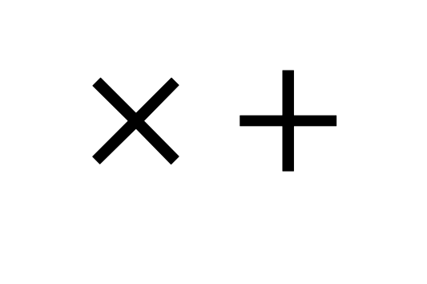
Who is this course for?
Designed for students with either AI or weather/climate background
No deep prior experience in both areas needed
Collaboration across disciplines is strongly encouraged
Lots of interaction and group work
Need you to download and install PollEverywhere on your phone: https://www.polleverywhere.com/
Main expert tools you need are:
$$× +$$

Slide 6
Structure of course
8 days:
2 1-hour lectures in the morning
1 1-hour guided coding class
2-3 hour self-guided coding exercise sheets in the afternoon
Computing labs use pytorch, AIFS and Anemoi
Lectures start from assuming no knowledge about NNs
Expect short quizzes, coding tasks, and pen-and-paper exercises
First quiz…

Slide 7

Notes:
Do not modify the notes in this section to avoid tampering with the Poll Everywhere activity. More info at polleverywhere.com/support In one or two words how would you describe your expertise? (e.g. Data Scientist, Meteorologist, Climate scientist, etc)
https://www.polleverywhere.com/free_text_polls/nsj1L6mLgbYEZsIFCTItp

Slide 8
Lecture 1: Linear regression to Neural networks

Slide 9
Learning outcomes
Reminder of linear regression (LR)
How to fit linear regression models
Thinking about LR as a neural network
Fitting LR like a neural network

Slide 10
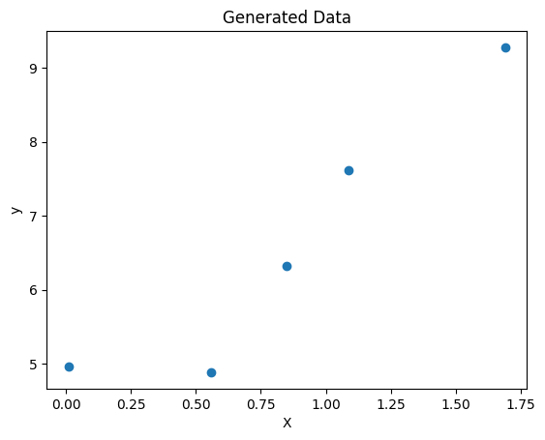
Drawing straight lines of best fit
Super simple data set:
X: [1.09 0.56 0.85 1.69 0.01]
y: [7.62 4.88 6.32 9.28 4.96]
Want a simple straight line of best fit through it

Slide 11
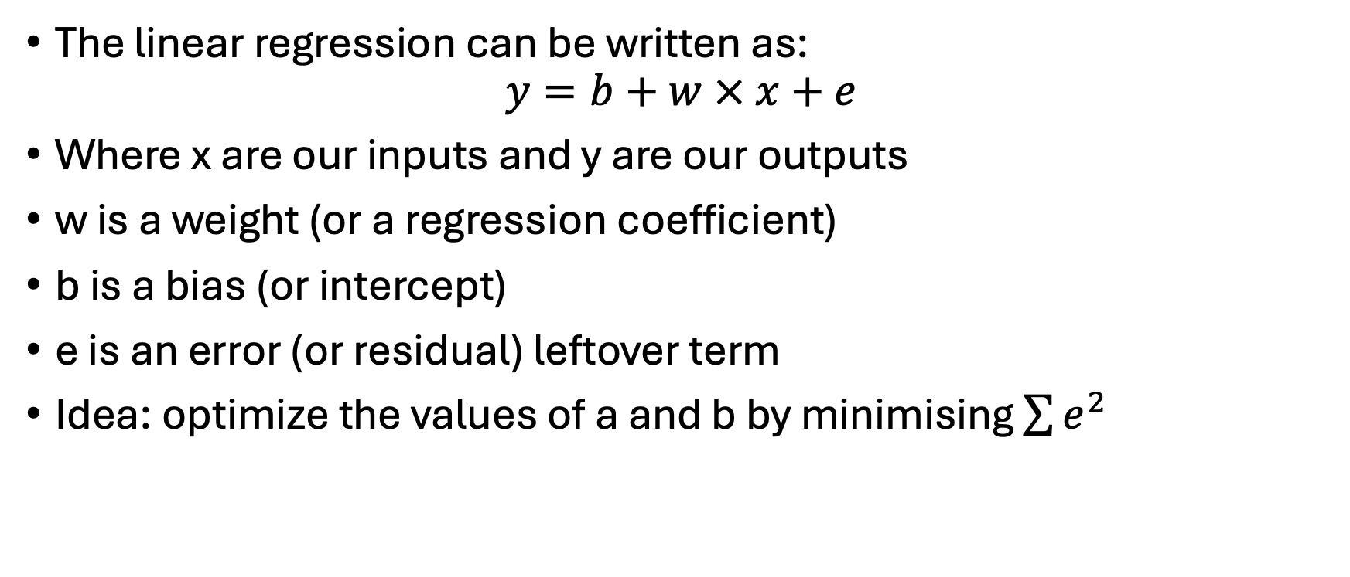
Foundations of linear regression
The linear regression can be written as:
$$y=b+w × x+e$$
Where x are our inputs and y are our outputs
w is a weight (or a regression coefficient)
b is a bias (or intercept)
e is an error (or residual) leftover term
Idea: optimize the values of a and b by minimising $\sum{e^{2}}$

Slide 12
Example
b = 1
w = 1
sum_of_squares = np.sum((y - (b + w * X)) ** 2)
Residual sum of squares for b=1, w=1: 120.61
b = 5
w = 0.5
sum_of_squares = np.sum((y - (b + w * X)) ** 2)
Residual sum of squares for b=5, w=0.5: 17.02

Slide 13
More intuition
w (weight) controls the slope of the line
b (bias) shifts the line up or down
Predicts continuous target values
Assumes linearity between input and output
Can actually fit this model exactly using calculus

Slide 14
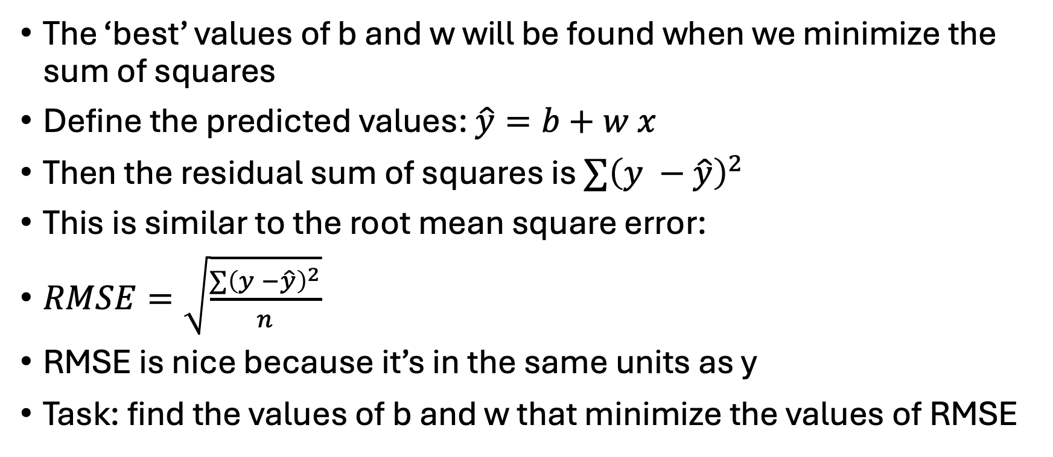
The loss function
The ‘best’ values of b and w will be found when we minimize the sum of squares
Define the predicted values: $\hat{y}=b+w x$
Then the residual sum of squares is $∑{\left(y −\hat{y}\right)}^{2}$
This is similar to the root mean square error:
$RMSE=\sqrt{\frac{∑{\left(y −\hat{y}\right)}^{2}}{n}}$
RMSE is nice because it’s in the same units as y
Task: find the values of b and w that minimize the values of RMSE

Slide 15
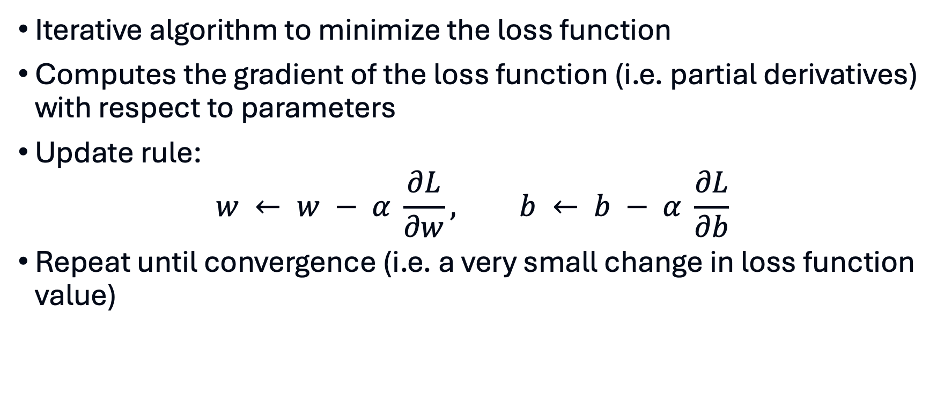
Solution via gradient descent
Iterative algorithm to minimize the loss function
Computes the gradient of the loss function (i.e. partial derivatives) with respect to parameters
Update rule:
$$w ← w − α \frac{∂L}{∂w}, b ← b − α \frac{∂L}{∂b}$$
Repeat until convergence (i.e. a very small change in loss function value)

Slide 16
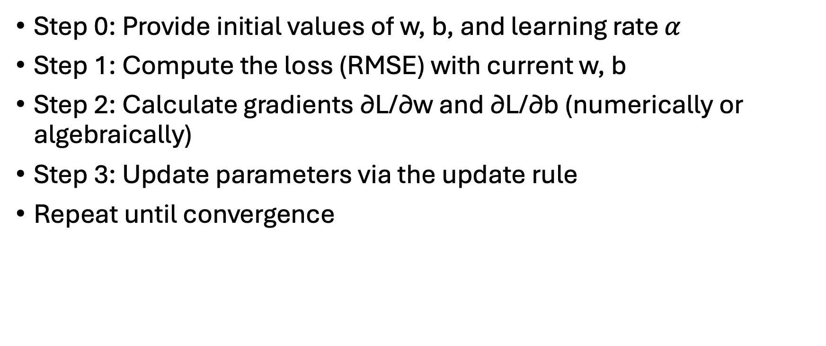
Algorithm
Step 0: Provide initial values of w, b, and learning rate $α$
Step 1: Compute the loss (RMSE) with current w, b
Step 2: Calculate gradients ∂L/∂w and ∂L/∂b (numerically or algebraically)
Step 3: Update parameters via the update rule
Repeat until convergence

Slide 17
In action
w, b = 0.0, 0.0
lr = 0.1
epochs = 100
losses = []
for epoch in range(epochs):
dw, db = compute_gradients(X, y, w, b)
w -= lr * dw
b -= lr * db
loss = rmse(y, predict(X, w, b))
if epoch % 10 == 0:
print(f'Epoch {epoch}, Loss: {loss:.4f}, w: {w:.4f}, b: {b:.4f}')
losses.append(loss)

Slide 18
In action
Epoch 0, Loss: 4.2132, w: 1.2831, b: 1.3222
Epoch 10, Loss: 0.4818, w: 3.2919, b: 3.7252
Epoch 20, Loss: 0.4780, w: 3.1685, b: 3.8940
Epoch 30, Loss: 0.4856, w: 3.0653, b: 3.9984
Epoch 40, Loss: 0.4910, w: 2.9919, b: 4.0724
Epoch 50, Loss: 0.4949, w: 2.9398, b: 4.1249
Epoch 60, Loss: 0.4977, w: 2.9028, b: 4.1622
Epoch 70, Loss: 0.4996, w: 2.8765, b: 4.1887
Epoch 80, Loss: 0.5010, w: 2.8579, b: 4.2075
Epoch 90, Loss: 0.5020, w: 2.8446, b: 4.2209

Slide 19
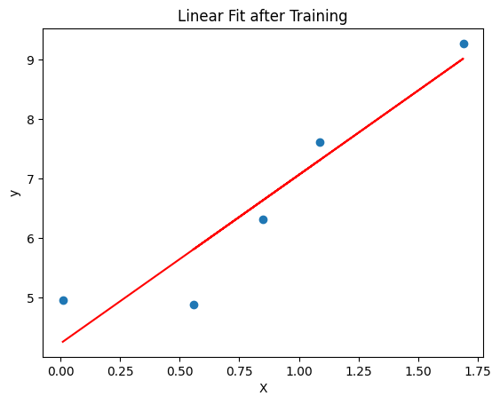
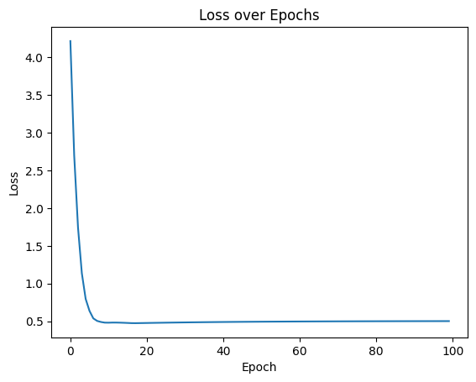
Plotting the fit

Slide 20
Learning rate
α controls the step size in gradient descent
Too small: slow convergence; too large: divergence
Often chosen empirically or via learning rate schedules
Adaptive optimizers (e.g. Adam, RMSProp) adjust the rate automatically

Slide 21
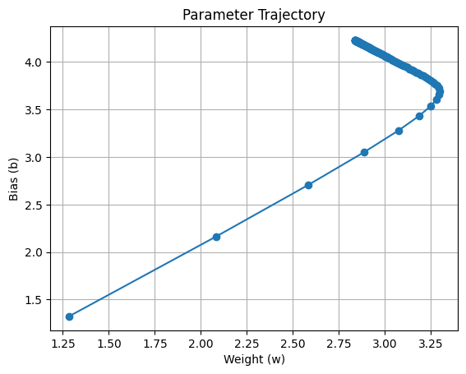
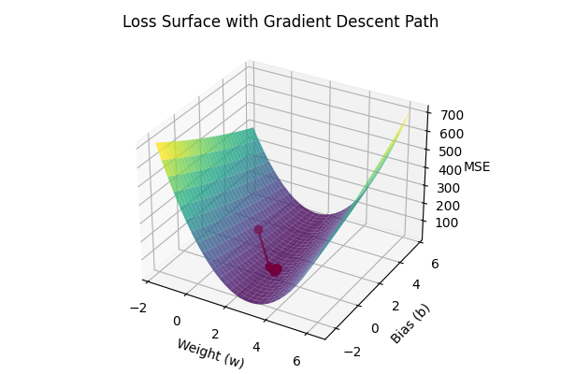
Parameter trajectories

Slide 22
Batch vs stochastic gradient descent
Batch GD: uses entire dataset each iteration; smooth but computationally heavy
Stochastic GD: updates using one sample; faster but noisy
Mini‑batch GD: compromise between the two
Noise in SGD can help escape shallow minima

Slide 23
Feature Scaling & Normalization
Inputs on different scales slow down optimization
Standardize by removing the mean and scaling to unit variance
Alternatively scale to [0,1] range (min–max scaling)
Improves numerical stability and convergence

Slide 24
Other practical tips
Monitor the loss on training and validation sets
Stop training when validation loss stops improving (early stopping)
Try different learning rates and schedules
Shuffle the data when using stochastic or mini‑batch GD
Use cross‑validation to select hyperparameters

